Slide 1
Conference Registration
Calculating Registration Fees for a Conference

Slide 2

Introduction
This presentation outlines the javaFX application that calculates registration fees for a conference including general and student pricing, optional dinners, and workshops.

Slide 3
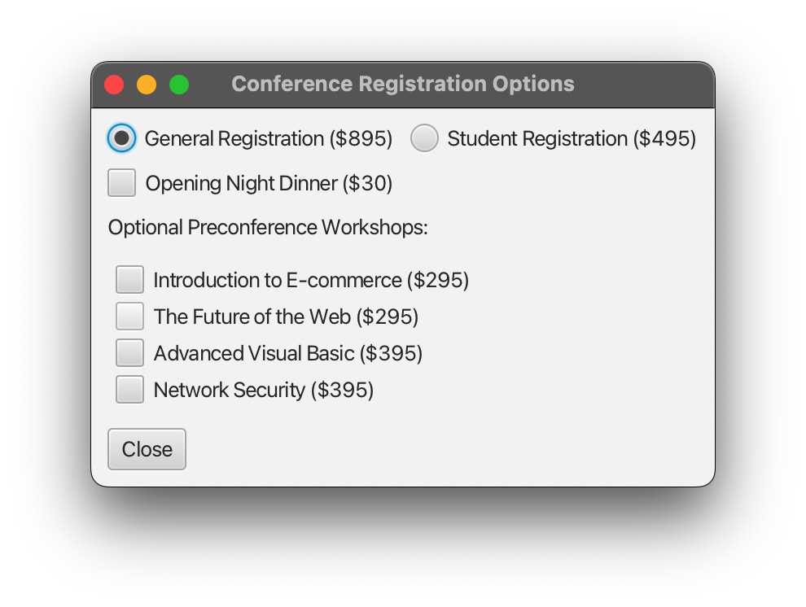
01
Registration Fees

Slide 4

General Registration Fee
The standard registration fee for attending the conference is set at $895 per person. This covers all main conference activities, materials, and access to networking opportunities.

Slide 5
Student Registration Fee
The special registration fee for students is priced at $495 per person. This discounted rate is aimed at encouraging student participation and engagement in the conference.

Slide 6
Optional Dinner Fee
The optional opening night dinner is available at an additional cost of $30 per person. This dinner includes a keynote speech and provides a great opportunity for networking and socializing before the conference begins.

Slide 7
02
Workshops

Slide 8

Introduction to E-commerce
This workshop, priced at $295, covers the basics of e-commerce including key strategies and tools for launching an online business.

Slide 9
The Future of the Web
Also priced at $295, this workshop delves into upcoming trends and technologies that will shape the future of the web, particularly in terms of user experience and design.

Slide 10
Network Security
This advanced workshop, offered at $395, focuses on essential network security techniques that professionals need to protect data and systems from cyber threats.

Slide 11
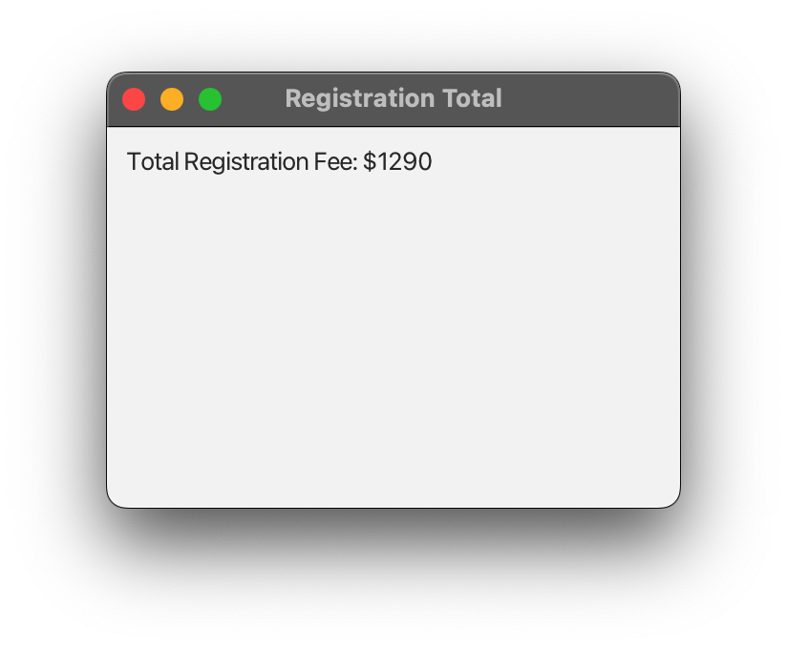
Total Fees Window

Slide 12

Conclusions
The JavaFX application allows participants to easily calculate their registration fees, including options for dinner and workshops, ensuring they can customize their conference experience.

Slide 13
Thank you!
Do you have any questions?

